Slide 1

Cox Regression … and a review of the hazard function
Steve Simon for
Notes:
Analyzing Repeated Measures Data Workshop: Module 5 The Linear Mixed Model
Copyright 2011 The Analysis Factor http://TheAnalysisFactor.com
1

Slide 2
Abstract
When you have data measuring the time to an event, you can examine the relationship between various predictor variables and the time to the event using a Cox proportional hazards model. In this talk, you will see what a hazard function is and describe the interpretations of increasing, decreasing, and constant hazard. Then you will examine the log rank test, a simple test closely tied to the Kaplan-Meier curve, and the Cox proportional hazards model.

Slide 3
Defining the hazard function
Rates versus proportions
There is an important, but subtle distinction
Both proportions and rates involve division.
A proportion is a count divided by another count.
It can never be larger than 1.
A rate is a count divided by a measure of time (or sometimes area).
It can sometimes be larger than 1.

Slide 4
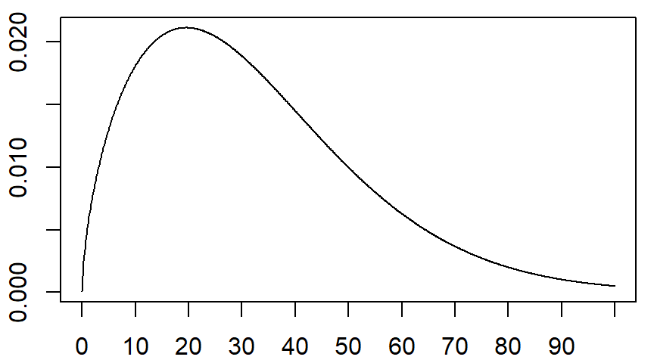
Defining the hazard function

Slide 5
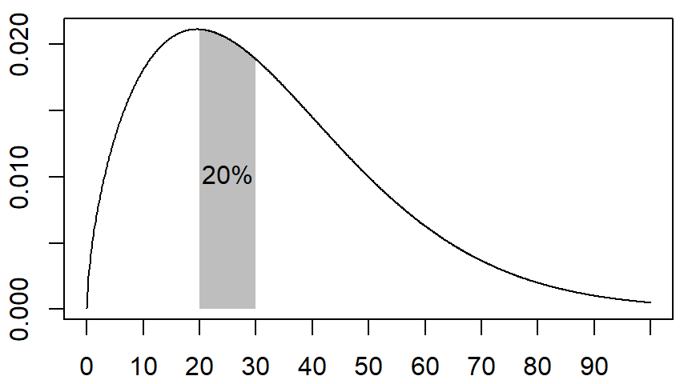
Defining the hazard function

Slide 6
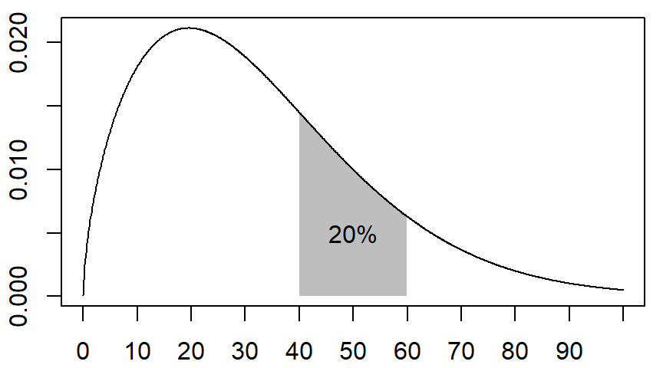
Defining the hazard function

Slide 7
Defining the hazard function
Are you comparing apples and oranges?
Three problems with these comparisons
The number of people alive at age 20 is much larger than the number of people alive at age 40.
The probabilities are measured across different time ranges.
The probabilities are quite heterogenous across the time intervals.

Slide 8
Defining the hazard function
To make a “fair” comparison
Adjust by the probability of surviving up to age 20 or age 40.
Calculate a death rate by dividing by the time range.
Calculate over a narrow time interval, Δt.

Slide 9
Defining the hazard function
Calculating a hazard function
The hazard function is defined as
h(t) = (P[t ≤ T ≤ t+Δt] / Δt) / P[T ≥t]
Key points
adjusted for the number surviving to that time (P[T ≥t]),
calculated as a rate (P[t ≤ T ≤ T+Δt] / Δt), not a probability, and
computed over a narrow time interval.

Slide 10
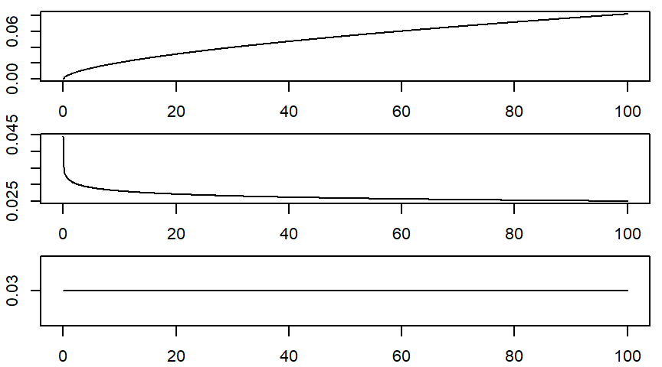
Defining the hazard function

Slide 11
Defining the hazard function
Why is the hazard function important?
Knowledge of the hazard function for an industrial product can help you decide on how and when to employ preventive maintenance.
It can also help you extrapolate survival patterns beyond the range of observed values, such as for long-term reliability testing.
If you are planning a new research study, the hazard function can help you decide how many patients to study and the length of follow-up for these patients.
Assumptions about the hazard function are critical for regression models of survival.

Slide 12


Defining the hazard function
The cumulative hazard function
The cumulative hazard function, H(t), is defined as
and it has an interesting relationship to the survival function.

Slide 13

Defining the hazard function
The cumulative hazard function
Calculation of the hazard function, h(t), from a set of data is quite difficult. Fortunately, you can calculate the cumulative hazard function, H(t), without much difficulty.
where d_{i} and n_{i} are the number of deaths and the number at risk at time t_{i}.

Slide 14
A simple example of the Cox regression model
Recall the limitations of the log rank test
The log rank test
works well when you’re comparing a treatment group to a control group
you can also use it when you have three or more groups.
But the log rank test does not extend beyond this:
you cannot include a continuous predictor,
you cannot analyze data with multiple predictors, and
you cannot do risk adjustment.

Slide 15
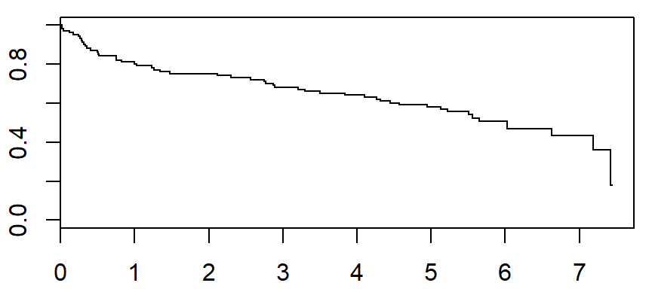
A simple example of the Cox regression model.
Always start with a plot of overall survival

Slide 16
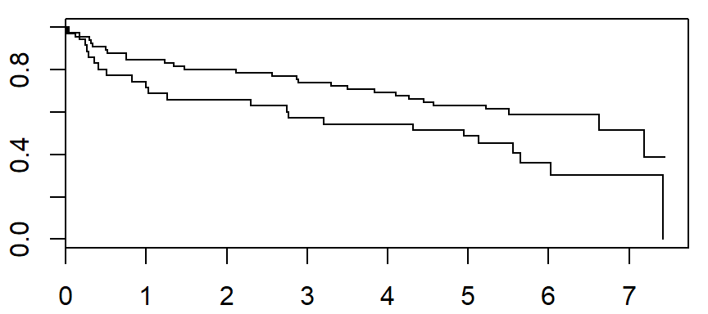
A simple example of the Cox regression model.
Then a Kaplan-Meier curve by groups

Slide 17
A simple example of the Cox regression model
The log rank test
Call:
survdiff(formula = Surv(time_yrs, fstat == "Dead") ~ gender,
data = whas100)
N Observed Expected (O-E)^2/E (O-E)^2/V
gender=Male 65 28 34.6 1.27 3.97
gender=Female 35 23 16.4 2.68 3.97
Chisq= 4 on 1 degrees of freedom, p= 0.0463

Slide 18
A simple example of the Cox regression model
The Cox regression model
Call:
coxph(formula = Surv(time_yrs, whas100$fstat == "Dead") ~ gender,
data = whas100)
n= 100, number of events= 51
coef exp(coef) se(coef) z Pr(>|z|)
genderFemale 0.5548 1.7416 0.2824 1.965 0.0494 *

Slide 19
A simple example of the Cox regression model
The Cox regression model
exp(coef) exp(-coef) lower .95 upper .95
genderFemale 1.742 0.5742 1.001 3.029
Concordance= 0.565 (se = 0.035 )
Rsquare= 0.037 (max possible= 0.985 )
Likelihood ratio test= 3.75 on 1 df, p=0.05293
Wald test = 3.86 on 1 df, p=0.04945
Score (logrank) test = 3.96 on 1 df, p=0.04665

Slide 20
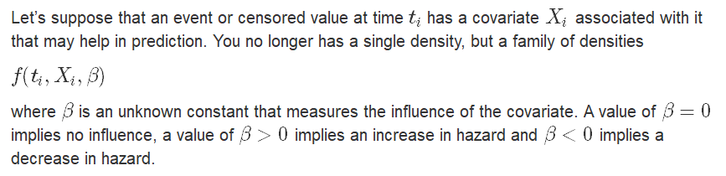
Mathematical details
A full likelihood approach

Slide 21
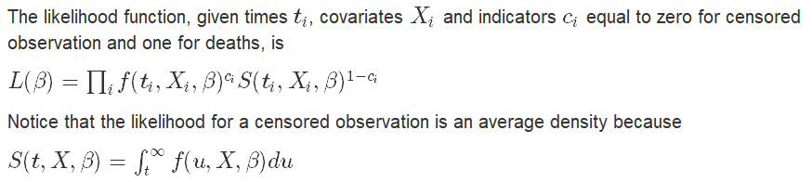
Mathematical details
A full likelihood approach

Slide 22
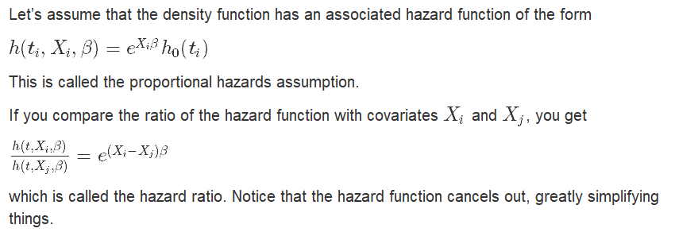
Mathematical details
Proportional hazards assumption

Slide 23
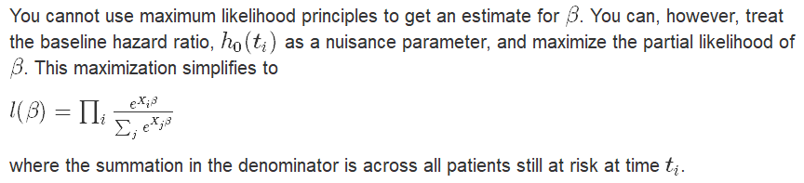
Mathematical details
Estimation via partial likelihood

Slide 24
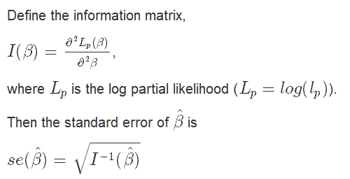
Mathematical details
The information matrix

Slide 25
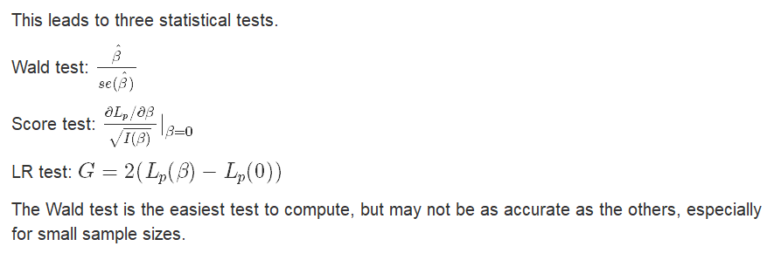
Mathematical details
The Wald, score, and likelihood ratio tests

Slide 26
A simple example of the Cox regression model
Revisiting the Cox regression model
coef exp(coef) se(coef) z Pr(>|z|)
genderFemale 0.5548 1.7416 0.2824 1.965 0.0494 *
The Wald test is 0.5548 / 0.284 = 1.965. Compare this to a normal distribution, to get a p-value of 0.0494. Reject the null hypothesis and conclude that there is an association between gender and mortality.

Slide 27
A simple example of the Cox regression model
Revisiting the Cox regression model
exp(coef) exp(-coef) lower .95 upper .95
genderFemale 1.742 0.5742 1.001 3.029
Since you used an indicator variable for gender, the exponential of the coefficient, 1.742, is the hazard ratio. Women are at 74% greater risk of mortality in this data set than men.

Slide 28
A simple example of the Cox regression model
Revisiting the Cox regression model
coef exp(coef) se(coef) z Pr(>|z|)
genderFemale 0.5548 1.7416 0.2824 1.965 0.0494 *
exp(coef) exp(-coef) lower .95 upper .95
genderFemale 1.742 0.5742 1.001 3.029
The 95% confidence interval for the hazard ratio is exp(0.5548 +/- 1.96*0.2824) = 1.001 to 3.029.

Slide 29
A simple example of the Cox regression model
Revisiting the Cox regression model
Likelihood ratio test= 3.75 on 1 df, p=0.05293
Wald test = 3.86 on 1 df, p=0.04945
Score (logrank) test = 3.96 on 1 df, p=0.04665
The three different statistical tests all produce (more or less) the same result. Note that the Wald test here is a square of the Z value of 1.965, and you should compare this to a chi-squared distribution.

Slide 30
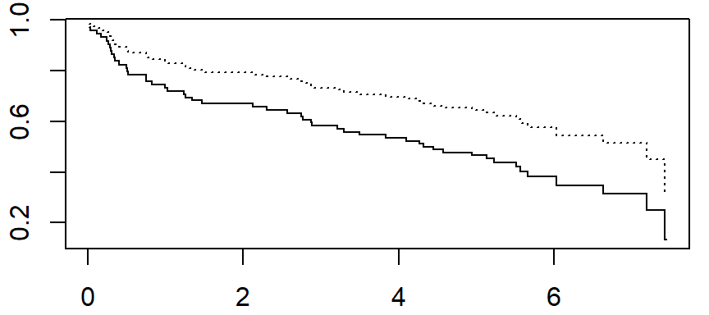
A simple example of the Cox regression model
You can plot the two estimated survival curves

Slide 31
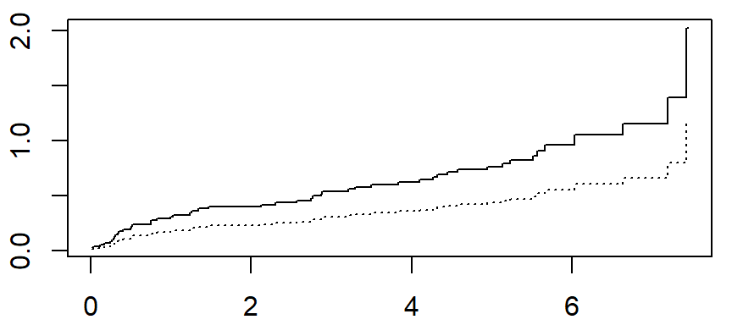
A simple example of the Cox regression model
..and the estimated cumulative hazard functions

Slide 32
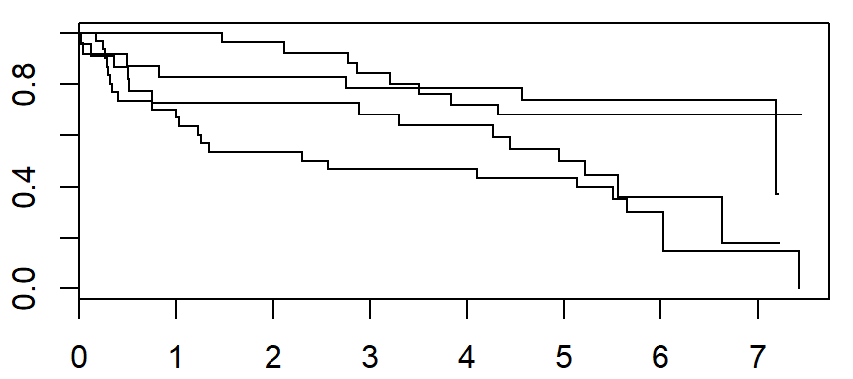
A second example of the Cox regression model
Start with the basic Kaplan-Meier curves

Slide 33
A second example of the Cox regression model
…and the logrank test
N Observed Expected (O-E)^2/E (O-E)^2/V
age_group=<60 25 8 15.5 3.64 5.29
age_group=60-69 23 7 12.9 2.71 3.68
age_group=70-79 22 14 10.2 1.39 1.76
age_group=>=80 30 22 12.3 7.57 10.18
Chisq= 15.6 on 3 degrees of freedom, p= 0.00139

Slide 34
A second example of the Cox regression model
Here are the Cox regression model results
coef exp(coef) se(coef) z p
age_group60-69 0.0472 1.0484 0.5186 0.09 0.9274
age_group70-79 0.9866 2.6820 0.4454 2.22 0.0267
age_group>=80 1.2634 3.5373 0.4155 3.04 0.0024
Likelihood ratio test=15.3 on 3 df, p=0.00155
n= 100, number of events= 5139

Slide 35
A second example of the Cox regression model
Here are the Cox regression model results
exp(coef) exp(-coef) lower .95 upper .95
age_group60-69 1.048 0.9539 0.3794 2.897
age_group70-79 2.682 0.3729 1.1204 6.420
age_group>=80 3.537 0.2827 1.5666 7.987

Slide 36
A second example of the Cox regression model
But you can include age as a continuous covariate
coef exp(coef) se(coef) z Pr(>|z|)
age 0.04567 1.04673 0.01195 3.822 0.000132 ***
exp(coef) exp(-coef) lower .95 upper .95
age 1.047 0.9554 1.022 1.072
Each additional year in age increases the risk of death by 4.7%.
Each additional decade increase in age leads to a hazard ratio of 1.047^10 = 1.579.

Slide 37
Conclusion
What have you learned today?
The hazard function is the short term death rate among those patients surviving to a specific time.
The log rank test is a simple test for comparing two or more Kaplan-Meier curves.
The Cox regression model allows for continuous predictors and risk adjustment.
The Cox model assumes proportional hazard functions and compares groups using a hazard ratio.

